Slide 1
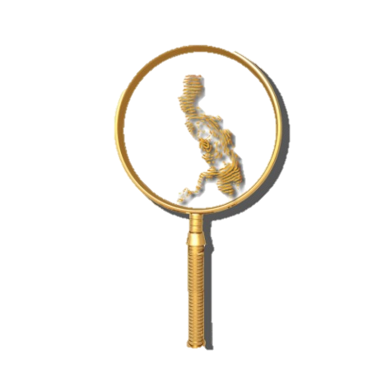
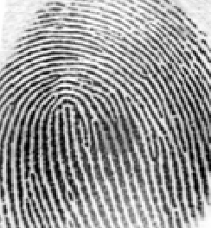
REVIEW QUESTIONS FOCUSED ON COMPETENCY # 1
By: ALFIE P. SARMIENTO, Ph.D.
5th Placer 1998
FISPhil Founding Officer

Slide 2
Fingerprint cannot be forged justifies the principle of
Persistency
Infallibility
Variation
permanency
Notes:
GTKPR – General acceptance (Frye) // Tested (has been) // Known Standards (ACE-V) //Peer Review and Publication //Rate of Error (Known potential) Daubert Criteria
Reliable – ability to produce consistent results /// repeatable – ability for a technique to produce consistent results by single person /// reproducible – ability for a technique to produce consistent results by other

Slide 3
According to Locard, how many pores must be in agreement to be sufficient to form an opinion on positive identification with poroscopy?
10-20
20-40
40-60
60-80

Slide 4
The first noticeable development of friction skin on the volar surfaces takes place at about______weeks gestation.
A) 4
B) 6
C) 10
D) 16

Slide 5
The deepest layer of cells next to the dermis is called the:
A) spinous
B) hyalin
C) basal
D) granular

Slide 6
The primary source of oils and fats found in perspiration is ______, a secretion of the sebaceous glands.
A) urea
B) peptides
C) sebum
D) none of these

Slide 7
(1898) This first case in which fingerprint evidence was used to secure a conviction transpired in ___________________.
A) State of Illinois
B) New York
C) Bengal
D) London

Slide 8
(1892) The first homicide case in Argentina solved by fingerprint evidence.
A) Julpaiguri Murder
B) Rojas Murder
C) Joseph Reibel
D) Stratton Case

Slide 9
The first trial in England that relied on fingerprint evidence involved an officer called by the name of _______?
A) Juan Vucetich
B) Charles Stockley Collins
C) Alphonse Bertillon
D) Edward Foster

Slide 10
The usual development of friction ridges on the human fetus transpire in the ________ months of fetal life:
A) third and fourth
B) seventh and eight
C) tenth and eleventh
D) seventeenth and eighteenth

Slide 11
The inner layer of epidermis that contains melanocyte cells, Merkel cells and keratinocyte cells. The layer of the epidermis where new keratinocytes are formed. Known as the germinative or generating layer.
A) Stratum Basale
B) Stratum corneum epidermidis
C) Stratum lucidum
D) Stratum granulosum epidermidis

Slide 12
The observation that nature never repeats itself is known as the Law of:
A) singularity
B) independent arrangement
C) biological uniqueness
D) none of the above

Slide 13
Clear layer of epidermis: the clear translucent layer of the epidermis, just beneath the stratum corneum.
A) Stratum spinosum
B) Stratum Mucosum
C) Stratum Malpighi
D) Stratum lucidum

Slide 14
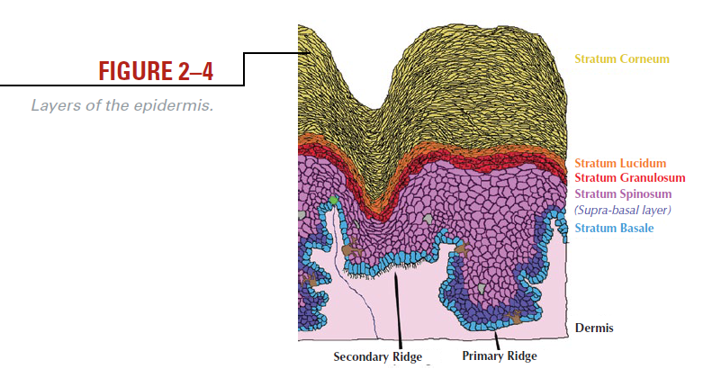
The outermost layer. Flat, arranged in rows as dead cells. Desmosomes undergo degradation.
Horny Layer
Hyalin Layer
Granular Layer
Spinous Layer
Generating Layer
Consists of flat and translucent dead cells that contain protein called eleidin. Appears only on palms and soles.
Initiates the process of keratinization associated with the dying process of cells. The last of the living cells.
Called the “pickle cells” because of the many-sided cells that have “spines” protruding from their surface.
Produces cells to replaced those being shed in the exposed superficial layer. The deepest layer; parallel to the basement membrane.

Slide 15
Who acted as expert witness in the famous case People vs Crispi?
A) Marry Holland
B) Joseph Faurot
C) Michael Evans
D) William Evans

Slide 16
(1939) This is the first case in United States where fingerprint individualization plays a major role in identifying disaster victims.
A) Sinking of Pearl Harbor
B) Pan Am Central Airliner crash
C) Sinking of USSSqualus
D) Typhoon Katrina

Slide 17
Who presented his study before the Royal Society in London about his observation on the appearances of ridges on the fingers and palms around 1684?
A)Robert Heindle
B)Henry Faulds
C)Prof. Johannes Herschel
D)Dr. Nehemiah Grew
D) Dr. Nehemiah Grew

Slide 18
One of the two layers of the dermis.
A) Papillary Pegs
B) Papillary Ridges
C) Papillary Layer
D) Papillae
Notes:
The other – reticular layer

Slide 19
Who was the lone Filipino FBI Agent that helped in the selection and training of forensic specialists including fingerprint technicians/examiners in the Philippines through the effort of the NBI?
Thomas Dugan
Generoso Reyes
Flaviano Guerrero
Agripino Ruiz

Slide 20
Who was the inmate at the Leavenworth Federal Prison initially confused with another resident convict after taking the Bertillon measurements?
William West
Bill West
Will West
Billy West

Slide 21
Purkinje described nine fingerprint patterns in 1823. What name did he used to refer to tented arches?
A)Transverse curves
B)Central longitudinal stria
C)Oblique Stripe
D)Almond
E)Composite
B

Slide 22
Whose fingerprint appears in the IAI Logo?
A)Henry Faulds
B)Francis Galton
C)Edward Henry
D)Juan Vucetich
B) Francis Galton

Slide 23
Which of the following cases held that the introduction into evidence of fingerprint impressions taken without the consent of the defendant is not an infringement of the constitutional rights against self-incrimination?
A)Commonwealth Vs. Albright (1931)
B)Schmerber Vs. California (1966)
C)State Vs. Cerciello (1914)
D)People Vs. Jennings (1911)
C) State Vs. Cerciello

Slide 24
United States v Kelly, 55 F.2d 67 (2d Cir. 1932)
Judge Augustus Hand decided that the taking of fingerprints upon lawful arrest, even in the absence of a statute so authorizing, does not violate the arrestee’s constitutional rights.

Slide 25
What fingerprint of Francis Galton appears in the IAI logo?
A)Right little
B)Right middle
C)Right thumb
D)Right index
D) Right index

Slide 26
Who is considered the father of fingerprint science in Germany?
A) Edward Foster
B) Wilhelm Eber
C) Edmund Locard
D) Harold Cummins
B) Wilhelm Eber

Slide 27
The classification system icnofalangometrica of Juan Vucetich means
finger description
finger track measurement
finger sorting
finger analysis

Slide 28
A professor of anatomy at the University of Bologna, noted in his treatise; ridges, spirals and loops in fingerprints. He made no mention of their value as a tool for individual identification.
A)HERSCHEL
B)PURKINJE
C)MALPIGHI
D)FAULDS
C) MALPIGHI

Slide 29
He published an atlas of anatomical illustrations. He was the first to enunciate the “skin ridges never duplicate in two persons”
A)J.C. Mayer
B)William Herschel
C)Francis Galton
D)Edmond Locard
A) J.C.A Mayer

Slide 30
An American who used his own fingerprint on commissary orders in New Mexico in order to prevent forgery, and was the first authenticated record of official use of fingerprints in the United States.
A)Mr. Gilbert Thompson
B)Samuel Clemens
C)Alphonse Bertillon
D)David Hepburn
A) Mr. Gilbert Thompson

Slide 31
Known as the Father of Fingerprints, Herschel's successor in India, who developed a fingerprint classification adopted in Scotland Yard, London.
A)Alphonse Bertillon
B)Sir Edward Richard Henry
C)Juan Vucetich
D)Dr. Henry P. de Forest
B) Sir Edward Richard Henry

Slide 32
Who was the first to author a book on Fingerprints; a British Scientist and cousin of the famous Charles Darwin?
A)Alphonse Bertillon
B)Sir Francis Galton
C)Samuel Clemens
D)Robert Heindle
B) Sir Francis Galton

Slide 33
Who was the FIRST PERSON to start a permanence study of friction ridge skin details?
A) Juan Vucetich
B)Herman Welcker
C)Samuel Clemens
D)Francis Galton

Slide 34
Who was the FIRST PERSON to publish in a journal the value of friction ridge skin for individualization, especially its use as evidence?
A) Juan Vucetich
B)Herman Welcker
C) Henry Faulds
D)Francis Galton

Slide 35
Who was the FIRST to identify the presence and locations of volar pads on the hands and feet?
A) Dr. Arthur Kollman
B) Herman Welcker
C) Henry Faulds
D) Francis Galton

Slide 36
Who introduced the ACE-V Methodology in friction ridge examination?
A) Huber, Roy
B) Mayfield, Brandon
C) Hollands, Marry
D) Ashbaugh, David
D) David Ashbaugh

Slide 37
Who introduced the ACE Methodology?
A) Huber, Roy
B) Mayfield, Brandon
C) Hollands, Marry
D) Ashbaugh, David
A) Roy Huber

Slide 38
Who coined the word Criminalistics?
A) Brourdel, P.
B) Gross, Hans
C) Fisher, John
D) Locard, Edmond
B) Hans Gross

Slide 39
Who introduced the study of the uniqueness of lip prints?
A) Fischer, R.
B) Locard, Edmond
C) Purkinje, John
D) Ashbaugh, David
A) R. Fischer

Slide 40
Who were convicted in Lyon, France around 1912 based on testimony deduced from sweat pores?
Mayfield
Simonin
Boudet
Jennings
Dillinger
A) I & II
B) II & III
C) IV & V
D) I & IV
Boudet and Simonin

Slide 41
Famous personality in the US who attempted to alter or change their fingerprints to hide identity?
Mayfield, Brandon
Pitts, Robert (Roscoe James)
Dillinger, John
Jennings, Thomas
A) I & II
B) II & III
C) IV & V
D) I & IV
Pitts and Dillinger

Slide 42
Who was the fingerprint examiner in the landmark case of fingerprint evidence presented in the People of the Philippines vs Marciano Medina?
A) Agripino Ruiz
B) Artemio Panganiban
C) Conrado Dumlao
D) James Rockwell
Agripino Ruiz

Slide 43
It is the first time whereby silver nitrate process was used to develop fingerprints.
A) the Lindbergh kidnapping
B) the Hamm kidnapping
C) the OJ case
D) Sam Sheppard case
Notes:
Hamm, Ernest – revised the logo of IAI enhancing the central fingerprint of Galton 1985
1933 FBI was credited with the first use of silver nitrate in the Hamm kidnapping (Hamm Brewing Vompany)

Slide 44
What was the first systematic use of fingerprinting in the U.S.?
Identification of prisoners in Pennsylvania penitentiary
Identification of civil servants in the state of New
York
C) Identification of soldiers in the U.S. Army
D) Identification of soldiers in the U.S. Navy

Slide 45
John Dillinger, during the Depression-era gangster, attempted to get rid of his fingerprints by what method?
A) Grafting the skin of someone else's fingertips onto his own
B) Shaving the outer layer of skin off his fingertips
C) Pouring sulfuric acid on his fingertips
D) Rubbing sandpaper on his fingertips

Slide 46
What crime was Brandon Mayfield, an Oregon lawyer, wrongly accused of based on a false fingerprint match?
A) 2005 London Underground train bombings
B) 2004 Madrid train bombings
C) 2001 Anthrax scare
D) 1997 Olympic Park Bombing

Slide 47
The first person to announce the discovery of friction ridge detail in primates (1823) was:
A) Charles Darwin
B) Johannes Purkinje
C) Martin Ledbetter
D) Nehemiah Grew

Slide 48
In 1896, this country became the first country in the world to abolish the anthropometry system:
A) United States
B) Argentina
C) France
D) Brazil

Slide 49
Comparison tests involving palmar flexion creases and their results have been performed and were reported in 1991 by:
A) SWGFAST
B) New Scotland Yard
C) the IAI
D) SCAFO

Slide 50
He was credited for his statistical model of fingerprint individuality, published in 1911. His model was very simplistic and ignored relevant information but was the foundation for others to develop improved statistical models. His work became the basis for Locard's Tripartite Rule.
A) Balthazard, Dr. Victor
B) Bayes, Rev. Thomas
C) Bayes, Rev. Thomas
D) Beck, Adolf

Slide 51
Implemented the Bertillon system in 1888 at the Chicago Police Department and implemented the fingerprint system in 1905 while he was the Chief of the Identity Bureau. Testified in "People vs. Jennings".
A) Evans, Edward A.
B) Evans, Captain Emmett A.
C) Evans, Captain Michael P.
D) Evans, William M.

Slide 52
His arrest was due to an erroneous fingerprint identification made by 3 FBI Examiners and 1 private fingerprint expert. The fingerprint was later identified to Algerian national Ouhnane Daoud.
A) Mayer, J.C.A.
B) Mayfield, Brandon
C) McClaughry, Major Robert Wilson
D) McClaughry, Matthew Wilson

Slide 53
The first case on record where a latent print was developed on a homicide victim's skin, identified to a suspect, and introduced as evidence in court.
A) State of Florida v. Stephen William Beattie
B) State of Florida v. Victor Reyes
C) State of Illinois v. Jennings
D) State of Maryland v. Bryan Rose

Slide 54
It is considered to be the first conviction obtained with fingerprint evidence alone in the United States year 1911.
A) People v Crispi
B) People v Jennings
People v Coral
People v Albright
*expert witness: Lt. Joseph Faurot NYPD

Slide 55
One of the first people Herschel fingerprinted as a means of identification. This is noted as the first practical uses of fingerprints.
A) Kuhl,Ben
B) Kuhne,Frederick
C) Konai,Rajyadhar
D) Kolliker, Rudolph Albert Von

Slide 56
An early researcher on the hands and feet of mammals. He classified many of the various epidermic formations as scales but separated the fine lines that covered the pads. He wrote "Die Schuppen der Saugetiere" ("The Scales of Mammals") in 1894 where he stated that ridges didn't evolve from scales, they are of secondary origin.
A) Reis, George
B) Asbury, David
C) Ross, Marion
D) Reh, Ludwig
Notes:
Reis – forensic photographer///Ross – SCRO case (murder victim)//Asbury – suspect//

Slide 57
One of the original researchers of friction skin. It doesn't appear that he was interested in individuality but rather the development and function of friction skin.
A) Herschel, Sir William James
B) Hepburn, Dr. David
C) Holt, Sarah B.
D) Hudson, Dr. Erastus Mead
Notes:
Hudson –developed the silver nitrate process used in the Lindbergh kidnapping 1932
Holt – studied dermatoglyphics (significance to medicine)

Slide 58
Acknowledged as the person responsible for implementing the Bertillon system in the United States. In 1887, he implemented this system while working as the Warden of the Illinois State Penitentiary at Joliet.
A) McClaughry, Matthew Wilson
B) McClaughry, Major Robert Wilson
C) McClaughry, Alan
D) McClaughry, John

Slide 59
Established by the FBI in 1995. In 1999, the name was changed to better reflect the goals of this group. This organization develops standards and guidelines in the area of friction skin identification.
A) SWGFAST
B) TWGFAST
C) NCIC
D) IAFIS

Slide 60
He wrote a book entitled "Finger Print Evidence" and in 1917 invented the metal identification tags for all the Navy men in WWI that had their fingerprints etched on them.
A) Taylor, Thomas
B) Taylor, James Herbert
C) Taylor, John
D) Taylor, Robert

Slide 61
A professor at the University of Bologna, Italy, this person published the results of his examination of friction skin with the newly invented microscope:
A) Johannes Pukinje
B) Marcello Malphighi
C) Govard Bidloo
D) none of the above

Slide 62
This person is known as the "Father of Canadian Fingerprinting.“
A) Juan Francisco Steegers y Perera
B) Edward Foster
C) James Carrick
D) William West

Slide 63
Thank you for your Patience!
GOOD LUCK
GOD BLESS!!!

