Slide 1
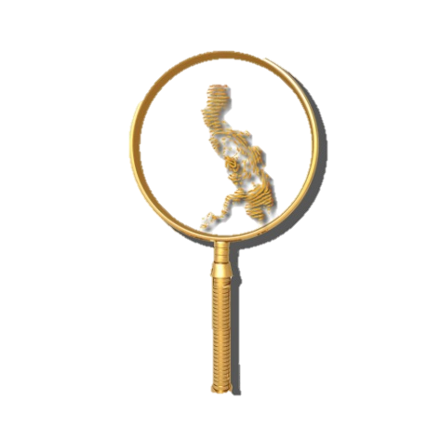
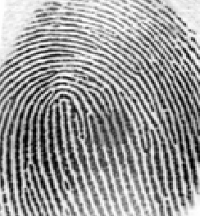
REVIEW QUESTIONS FOCUSED ON COMPETENCY # 2
By: ALFIE P. SARMIENTO, Ph.D.
5th Placer 1998
FISPhil Founding Officer

Slide 2
Which of the following cases held that the introduction into evidence of fingerprint impressions taken without the consent of the defendant is not an infringement of the constitutional rights against self-incrimination?
A)Commonwealth Vs. Albright (1931)
B)Schmerber Vs. California (1966)
C)State Vs. Cerciello (1914)
D)People Vs. Jennings (1911)
C) State Vs. Cerciello

Slide 3
United States v Kelly, 55 F.2d 67 (2d Cir. 1932)
Judge Augustus Hand decided that the taking of fingerprints upon lawful arrest, even in the absence of a statute so authorizing, does not violate the arrestee’s constitutional rights.

Slide 4
Blood type is a form of class evidence whereby DNA is said to be
Conclusive evidence
individualistic
Best evidence
generic

Slide 5
Transferred impression of friction ridge detail not readily visible; generic term used for questioned friction ridge detail.
A)Latent Print
B)Exemplar
C)Patent Print
D)Inked print
A) Latent Print

Slide 6
The methodical examination of friction skin impressions; separation into parts to determine the nature of the whole.
A)Comparison
B)Evaluation
C)Verification
D)Analysis
D) Analysis

Slide 7
Any distortion or alteration not in the original friction ridge impression, produced by an external agent or action.
A)Compression
B)Artifact
C)Dermabrasion
D)Discrepancy
B) Artifact

Slide 8
The determination of the significance, value, or clarity of a friction ridge impression by careful observation and study.
A)Analysis
B)Comparison
C)Evaluation
D)Verification
C) Evaluation

Slide 9
The determination that two areas of friction ridge impressions did not originate from the same source.
A)INDIVIDUALIZATION
B)EXCLUSION
C)INCONCLUSIVE
D)INTERPOLATION
B) EXCLUSION

Slide 10
Type of fingerprint which is also known as molded or impressed prints.
A)Latent
B)Plastic
C)Latent
D)Patent
B)Plastic

Slide 11
What is ALPS?
A)Automated Latent Print System
B)Authenticated Latent Print System
C)Automated Latent Pattern System
D)Authenticated Latent Pattern System
A) Automated Latent Print System

Slide 12
The incorrect determination that two areas of friction ridge impressions originated from the same source.
A)false negative
B)individualization
C)discrepancy
D)erroneous identification
D) Erroneous identification

Slide 13
The determination that two areas of friction ridge impressions did not originate from the same source.
A)erroneous identification
B)discrepancy
C)False positive
D)exclusion
D) exclusion

Slide 14
The following are techniques in fingerprint development except
A)flame technique
B)dusting
C)Chemical development
D)photography
D) photography

Slide 15
It is referred to as friction ridge flow and general morphological information.
A)level 1 detail
B)Level 2 detail
C)Level 3 detail
D)Level 4 detail
A) Level 1 detail

Slide 16
It is known as individual friction ridge paths and friction ridge events such as ending ridges, dots, enclosure etc.
A)level 1 detail
B)Level 2 detail
C)Level 3 detail
D)Level 4 detail
B) Level 2 detail

Slide 17
It is defined as friction ridge dimensional attributes.
A)level 1 detail
B)Level 2 detail
C)Level 3 detail
D)Level 4 detail
C) Level 3 detail

Slide 18
It is also known as missed identification .
A)false negative
B)False positive
C)inconclusive
D)non-identification
A) False negative

Slide 19
It is a generic term used for questioned friction ridge detail
A)patent print
B)Latent print
C)Plastic print
D)fingerprint
B) Latent print

Slide 20
It is a friction ridge impression of unknown origin which is visible without development.
A)patent print
B)Latent print
C)Plastic print
D)fingerprint
A) Patent print

Slide 21
Who introduced the ACE-V Methodology in friction ridge examination?
A) Huber, Roy
B) Mayfield, Brandon
C) Hollands, Marry
D) Ashbaugh, David
D) David Ashbaugh

Slide 22
Who introduced the ACE Methodology?
A) Huber, Roy
B) Mayfield, Brandon
C) Hollands, Marry
D) Ashbaugh, David
A) Roy Huber

Slide 23
Amino acids are secreted by the ______________.
A) Apocrine glands
B) Sebaceous glands
C) Eccrine glands
D) Salivary glands
Eccrine

Slide 24
Any distortion or alteration not in the original friction ridge impression, produced by an external agent or action.
A) Compression
B) Artifact
C) Dermabrasion
D) Discrepancy

Slide 25
Question 65
It is the first time whereby silver nitrate process was used to develop fingerprints.
A) the Lindbergh kidnapping
B) the Hamm kidnapping
C) the OJ case
D) Sam Sheppard case

Slide 26
Question 67
The FBI's database used for storing fingerprints is:
A) IBIS
B) IAFIS
C) CODIS
D) USDA

Slide 27
Question 70
John Dillinger, during the Depression-era gangster, attempted to get rid of his fingerprints by what method?
A) Grafting the skin of someone else's fingertips onto his own
B) Shaving the outer layer of skin off his fingertips
C) Pouring sulfuric acid on his fingertips
D) Rubbing sandpaper on his fingertips

Slide 28
Question 71
What crime was Brandon Mayfield, an Oregon lawyer, wrongly accused of based on a false fingerprint match?
A) 2005 London Underground train bombings
B) 2004 Madrid train bombings
C) 2001 Anthrax scare
D) 1997 Olympic Park Bombing

Slide 29
Question 75
The methodology of friction ridge identification is known as:
A) Confirmation Testing
B) Peer Review
C) ACE-V
D) Ridgeology

Slide 30
Question 77
The intrinsic or innate ridge formations are called
A) Level 1 detail
B) Level 2 detail
C) Level 3 detail
D) Level 4 detail

Slide 31
Question 87
When fingerprinting the dead and rigor mortis has set in and the fingers are tightly clenched, the fingers may be:
A) forcibly straightened by "breaking the rigor"
B) immersed in sodium hydroxide to gently "loosen the rigor"
C) immersed in alcohol to gently "loosen the rigor"
D) none of the above

Slide 32
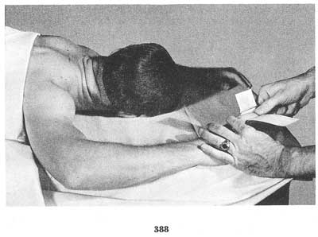

Slide 33
Question 105
A systematic recording of all of the friction ridge detail appearing on the palmar sides of the hands. This includes the extreme sides of the palms, and joints, tips and sides of the fingers.
A) MATRIX
B) MEDIAL
C) MAJOR CASE PRINTS
D) MINOR CASE PRINTS

Slide 34
Question 107
Term commonly used in the United Kingdom and some Commonwealth countries to designate a latent print.
A) Mark
B) Print
C) Matrix
D) Art

Slide 35
Question 108
His arrest was due to an erroneous fingerprint identification made by 3 FBI Examiners and 1 private fingerprint expert. The fingerprint was later identified to Algerian national Ouhnane Daoud.
A) Mayer, J.C.A.
B) Mayfield, Brandon
C) McClaughry, Major Robert Wilson
D) McClaughry, Matthew Wilson

Slide 36
Question 109
A lighting technique used to visualize latent friction ridge impressions where the light is directed on an object in a sloping direction.
A) Forensic Light Source
B) Fluorescence
C) Oblique Lighting
D) Parallel Lighting

Slide 37
Question 153
A recording of an individual's friction ridges with black ink, electronic imaging, photography, or other medium on a contrasting background.
A) LATENT PRINT
B) KNOWN PRINT
C) PATENT PRINT
D) TEN PRINT

Slide 38
Question 156
Computerized system for storage, searching and
retrieval of known and latent palm print records based on friction ridge detail.
A) APIS
B) AFIS
C) IBIS
D) IAI

Slide 39
Question 170
Exemplars of friction ridge skin detail of persons known to have had access to the item examined for latent prints.
A) ELIMINATION PRINTS
B) STANDARD PRINTS
C) EXCLUSION PRINTS
D) INCONCLUSIVE PRINTS

Slide 40
Question 171
Variances in the reproduction of friction skin caused by pressure, movement, force, contact surface, etc.
A) DISSOCIATED RIDGES
B) DOWN SAMPLING
C) DISTORTION
D) TRAUMA

Slide 41
Question 173
A fingerprint image left in a soft pliable surface, such as clay or wax. Also referred to as a molded print or an impressed print.
A) LATENT PRINT
B) KNOWN PRINT
C) PLASTIC PRINT
D) PATENT PRINT

Slide 42
Question 174
When the ridges of an image are a different color from the background and the furrows of an image are the same color as the background, as opposed to a negative image.
A) NEGATIVE PRINT
B) POSITIVE PRINT
C) KNOWN PRINT
D) INKED PRINT

Slide 43
Question 175
A mark remaining after the healing of a wound.
A) SEBUM
B) SCAR
C) SCRAF SKIN
D) MOTTLED SKIN

Slide 44
Question 177
The first case on record where a latent print was developed on a homicide victim's skin, identified to a suspect, and introduced as evidence in court.
A) State of Florida v. Stephen William Beattie
B) State of Florida v. Victor Reyes
C) State of Illinois v. Jennings
D) State of Maryland v. Bryan Rose

Slide 45
Question 181
The independent examination of one or more friction ridge impressions at any stage of the ACE process by another competent examiner who is provided with no, or limited, contextual information, and has no expectation or knowledge of the determinations or conclusions of the original examiner.
A) Blind Testing
B) Blind Verification
C) Blind Analysis
D) Blind Comparison

Slide 46
Question 182
The effect of perceptual or mental processes on the reliability and validity of one's observations and conclusions.
A) Cognitive Influences
B) Cognitive Bias
C) Cognition
D) Classical Probability

Slide 47
Question 183
It is considered to be the first conviction obtained with fingerprint evidence alone in the United States year 1911.
A) People v Crispi
B) People v Jennings
People v Coral
People v Albright
*expert witness: Lt. Joseph Faurot NYPD

Slide 48
Question 184
The amount of variation in appearance of friction ridge features to be allowed during a comparison, should a corresponding print be made available.
A) Quantity
B) Variable
C) Tolerance
D) Sufficiency

Slide 49
Question 186
This involves preparing photographic enlargements of the latent and inked fingerprints. A grid of equally-sized squares is then superimposed on each, with the squares of each grid occupying identical positions on each print. The forensic scientist examines both imprints square by square looking for identical characteristics.
A) Osborn Grid Method
B) James Grid Method
C) Purkinje Grid Method
D) West Grid Method

Slide 50
Question 188
The applied science of identification by friction skin based on the Theory of Differential Growth and the Theory of Permanence.
A) Fingerprint Identification
B) Pattern Identification
C) Skin Identification
D) Ridge Formation

Slide 51
Question 193
Established by the FBI in 1995. In 1999, the name was changed to better reflect the goals of this group. This organization develops standards and guidelines in the area of friction skin identification.
A) SWGFAST
B) TWGFAST
C) NCIC
D) IAFIS

Slide 52
Question 196
A ridge break may be caused by:
A) a dirt
B) a failure in matrix deposition
C) incorrect deposition pressure
D) any of the above
E) none of the above

Slide 53
Question 199
The observation that nature never repeats itself is known as the Law of:
A) singularity
B) independent arrangement
C) biological uniqueness
D) none of the above

Slide 54
Thank you for your Patience!
GOOD LUCK
GOD BLESS!!!

