Slide 1
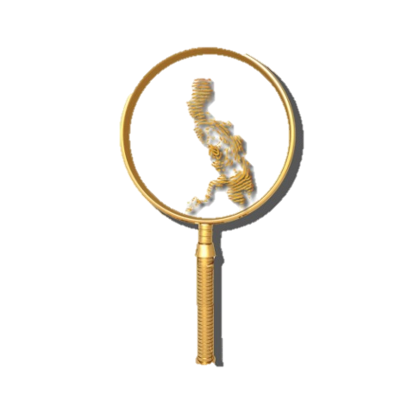
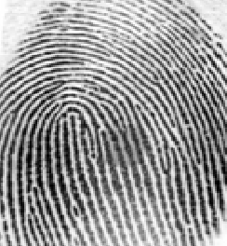
REVIEW QUESTIONS FOCUSED ON COMPETENCY # 3
By: ALFIE P. SARMIENTO, Ph.D.
5th Placer 1998
FISPhil Founding Officer

Slide 2
In deriving the primary classification, the ten fingerprints are divided into five pairs. The first pair is composed of the
A)right thumb and right index finger
B)left thumb and left index finger
C)right middle and right ring finger
D)right little finger and left thumb
A

Slide 3
What Henry classification is derived by ridge counting the loop appearing in the right or left little finger?
A)Major Classification
B)Key Classification
C)Final Classification
D)Sub-secondary Classification
C) Final Classification

Slide 4
What Henry classification involves ridge counting the first loop in the ten print card starting from the right thumb except the little fingers?
A)Final Classification
B)Key Classification
C)Major Classification
D)Primary Classification
B) Key Classification

Slide 5
When there are 3 or more intervening ridges above the right delta, the tracing is called
A)Meeting
B)Inner
C)Outer
D)none of these
B) Inner

Slide 6
How do fingerprint examiners ridge count plain whorls?
A)the left delta to the core in left hand.
B) Treat it as ulnar loops
C) the right delta to the core in right hand.
D) Treat it as radial loops
E) Perform ridge tracing
B) Treat it as ulnar loops

Slide 7
Which of the following is not represented by numerical symbol?
A)Primary
B)Key
C)Major
D)final
C) Major

Slide 8
If two index fingers were amputated, both will be classified as
A)similar to their counterpart fingers.
B) Plain whorls with meeting tracings.
C)of whorls with no additional reference.
D)identical to the opposite fingers.
B) Plain whorls with meeting tracings.

Slide 9
In a set of prints containing all whorl type patterns, the key classification is obtained by
A)conducting ridge tracing on whorls
B)putting a dash on the numerator
C) ridge counting the first whorl appearing in the ten print
D)leaving it blank
C

Slide 10
The little white lines that are found on a fingerprint that looks like scars of blisters and burns are referred to as
A)Scars
B)Warts
C)Furrows
D)creases
D) creases

Slide 11
It is defined as inner terminus of the fingerprint pattern.
A)Core
B)Delta
C)Dermis
D)Dot
A) Core

Slide 12
What is the probability ratio that two person might have identical fingerprints according to Francis Galton?
1 in 64 million
1 in 6 million
1 in 64 billion
1 in 6 billion

Slide 13
What is the NCIC code of a fingerprint exhibiting a plain whorl with three intervening ridges above the right delta?
WI
WO
PI
PO

Slide 14
The classification system icnofalangometrica of Juan Vucetich means
finger description
finger track measurement
finger sorting
finger analysis

Slide 15
What NCIC code of shall be used if a finger shows the requisites of a radial loop with 15 ridge counts?
15
(I) for inner
(O) for outer
65

Slide 16
Which of the following codes reflect Francis Galton’s elementary fingerprint classification system?
WWWLLLWLLW
AULSRSWUXXSRUCUPLSRS
XXPIdIXOSRTTAA6049dM
M 32 W MMM
M 32 W MMM

Slide 17
When two complementary strands of DNA are hybridized or bound together a ladder like structure is formed. Because of the three dimensional structure of the chemical components in the backbone, a spiral configuration results. This natural state of DNA is called
Double coil
Double spiral
Double helix
Double strands

Slide 18
Which of the foregoing is a type of DNA that contains more unique features?
Mitochondrial DNA
DNA strand
Nuclear DNA
Molecular DNA

Slide 19
Blood type is a form of class evidence whereby DNA is said to be
Conclusive evidence
individualistic
Best evidence
generic

Slide 20
A type of fingerprint pattern that possesses an angle, an upthrust, or two of the three basic characteristics of the loop.
A)ARCH – PLAIN
B)ARCH –TENTED
C)LOOP – ULNAR
D)LOOP - RADIAL
B) ARCH –TENTED

Slide 21
Any distortion or alteration not in the original friction ridge impression, produced by an external agent or action.
A)Compression
B)Artifact
C)Dermabrasion
D)Discrepancy
B) Artifact

Slide 22
Two or more fingers connected along the sides by skin.
A)PENTADACTYLY
B)SYNDACTYLY
C)BRACHYDACTYLY
D)ECTRODACTYLY
B) SYNDACTYLY

Slide 23
A bifurcation with one short ridge branching off a longer ridge.
A)BIFURCATION
B)SPUR
C)DELTA
D)DOT
B) SPUR

Slide 24
A friction ridge not fully developed which may appear shorter and thinner in appearance than fully developed friction ridges (interstitial, nascent).
A)INCIPIENT RIDGE
B)INTERVENING RIDGE
C)PAPILLARY RIDGE
D)FRICTION RIDGE
A) INCIPIENT RIDGE

Slide 25
An alpha expression derived from the pattern of the index fingers.
A)SUB SECONDARY
B)SECONDARY
C)MAJOR
D)KEY
B) SECONDARY

Slide 26
The space between the shoulders of a loop, free of any appendages that abut upon the recurve at a right angle on the outside.
A)SUFFICIENT RECURVE
B)TYPE LINES
C)BRIDGE
D)DIVERGENCE
A) SUFFICIENT RECURVE

Slide 27
A type of pattern in which one or more ridges enter upon either side, recurve, touch or pass an imaginary line between delta and core and pass out, or tend to pass out, on the same side the ridges entered. The flow of the pattern runs toward the little finger.
A)LOOP – ULNAR
B)LOOP – RADIAL
C)WHORL – PLAIN
D)WHORL - DOUBLE LOOP
A) LOOP – ULNAR

Slide 28
Those areas that are enclosed within the pattern area of loops and whorls. They are also known as the core and the delta.
A)FULCRUM AREA
B)FRICTION RIDGE UNIT
C)FOCAL POINTS
D)FIBULAR AREA
C) FOCAL POINTS

Slide 29
A type of fingerprint pattern which has two deltas and at least one ridge which makes, or tends to make, one complete circuit, which may be spiral, oval, circular, or any variant of a circle. An imaginary line drawn between the two deltas must not touch or cross any recurving ridges within the inner pattern area.
A)WHORL – ACCIDENTAL
B)WHORL - DOUBLE LOOP
C)WHORL - CENTRAL POCKET
D)WHORL - PLAIN
C) WHORL - CENTRAL POCKET

Slide 30
A type of pattern in which one or more ridges enter upon either side, recurve, touch or pass an imaginary line between delta and core and pass out, or tend to pass out, on the same side the ridges entered. The flow of the pattern runs toward the thumb.
A)LOOP – ULNAR
B)LOOP – RADIAL
C)WHORL – PLAIN
D)WHORL - DOUBLE LOOP
B) LOOP – RADIAL

Slide 31
An alpha expression derived from the index, middle and ring fingers of both hands.
A)KEY
B)MAJOR
C)FINAL
D)SUB-SECONDARY
D) SUB-SECONDARY

Slide 32
Ridge detail is present, but is dissociated due to trauma or genetic causes. It lacks any continuous pattern flow.
A)SCARF SKIN
B)MOTTLED SKIN
C)CREASE
D)SPUR
B) MOTTLED SKIN

Slide 33
That point on a ridge at or nearest to the point of divergence of two type lines, and located at or directly in front of the point of divergence.
A)CORE
B)DOT
C)FURROWS
D)DELTA
D) DELTA

Slide 34
What is ALPS?
A)Automated Latent Print System
B)Authenticated Latent Print System
C)Automated Latent Pattern System
D)Authenticated Latent Pattern System
A) Automated Latent Print System

Slide 35
It is referred to as friction ridge flow and general morphological information.
A)level 1 detail
B)Level 2 detail
C)Level 3 detail
D)Level 4 detail
A) Level 1 detail

Slide 36
It is known as individual friction ridge paths and friction ridge events such as ending ridges, dots, enclosure etc.
A)level 1 detail
B)Level 2 detail
C)Level 3 detail
D)Level 4 detail
B) Level 2 detail

Slide 37
It is defined as friction ridge dimensional attributes.
A)level 1 detail
B)Level 2 detail
C)Level 3 detail
D)Level 4 detail
C) Level 3 detail

Slide 38
It is also known as ridge characteristics.
A)minutiae
B)typica
C)Galton details
D)All of the above
D) All of the above

Slide 39
Galton details are best described as
A)level 1 detail
B)Level 2 detail
C)Level 3 detail
D)Level 4 detail
B) Level 2 detail

Slide 40
It is the point at which one friction ridge divides into three friction ridges.
A)trident
B)webbing
C)trifork
D)None of the above
D) None of the above

Slide 41
Approximately 25% of the population falls into which primary classification?
A) 0/0
B) 25/25
C) 1/1
D) 20/20
E) 50/50

Slide 42
The intrinsic or innate ridge formations are called
A) Level 1 detail
B) Level 2 detail
C) Level 3 detail
D) Level 4 detail

Slide 43
When two bifurcations form on the same ridge facing each other and their branches join, the formation is called
A) spur
B) dot
C) enclosure
D) trifurcation

Slide 44
A whorl in the right middle finger would be given the numerical value of __ in calculating the Primary Value of the Henry Classification System.
A) 2
B) 4
C) 8
D) 16

Slide 45
Congenital absence of friction ridge skin is known as:
A) ridge dysplasia
B) ridge aplasia
C) ridge dysphasia
D) none of the above

Slide 46
The core of a loop is placed upon or within _____.
A) the innermost sufficient recurve
B) the innermost ridge
C) the innermost recurve
D) any of the above

Slide 47
Type lines may be defined as the two innermost ridges which start parallel, diverge, and surround or tend to surround _____________.
A) the core
B) the delta
C) the pattern area
D) an upthrust

Slide 48
An area comprised of the combination of ridge flow, ridge characteristics, and ridge structure.
A) FRICTION RIDGE
B) FRICTION RIDGE UNIT
C) FRICTION RIDGE IDENTIFICATION
D) FRICTION RIDGE DETAIL

Slide 49
A sampling technique used to increase the size of an image file by creating more pixels and increasing the apparent resolution of an image. When used to decrease image size, interpolation is generally referred to as down sampling.
A) INTERDIGITAL
B) Image Retrieval System
C) INTERPOLATION
D) INDIVIDUALIZATION

Slide 50
He was credited for his statistical model of fingerprint individuality, published in 1911. His model was very simplistic and ignored relevant information but was the foundation for others to develop improved statistical models. His work became the basis for Locard's Tripartite Rule.
A) Balthazard, Dr. Victor
B) Bayes, Rev. Thomas
C) Bayes, Rev. Thomas
D) Beck, Adolf

Slide 51
In the distal phalange of the fingers, the configuration of friction ridges that are utilized in classification.
A) PATTERN FORMATIONS
B) PATTERNS
C) PATTERN AREA
D) PATTERN CLASSIFICATION

Slide 52
Area located at the heel of the foot.
A) Ball area
B) Calcar area
C) Calpar area
D) Phalange area

Slide 53
Underdeveloped ridges associated with an excess of creases.
A) RIDGE DYSPLASIA
B) RIDGE DISSOCIATION
C) RIDGE FLOW
D) RIDGE HYPOPLASIA

Slide 54
End to end fusion of the phalanges of the fingers or toes.
A) SURFACTANT
B) SYMPHALANGY
C) SYNDACTYLY
D) SYNPERONIC

Slide 55
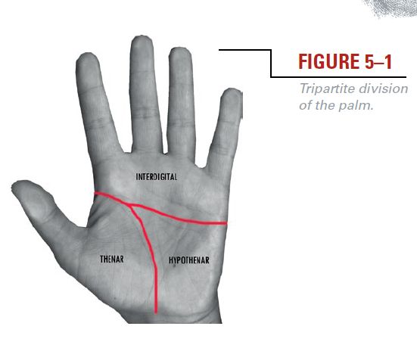
The large cushion of the palm located at the base of the thumb.
A) THENAR AREA
B) BALL AREA
C) CALCAR AREA
D) PHALANGE

Slide 56
Term commonly used in the United Kingdom and some Commonwealth countries to designate a latent print.
A) Mark
B) Print
C) Matrix
D) Art

Slide 57
A lighting technique used to visualize latent friction ridge impressions where the light is directed on an object in a sloping direction.
A) Forensic Light Source
B) Fluorescence
C) Oblique Lighting
D) Parallel Lighting

Slide 58
Reagent used to detect/enhance bloody friction ridge detail.
A) CYCLOHEXANE
B) CROWLE'S DOUBLE STAIN
C) CRYSTAL VIOLET
D) DIAMINOBENZIDINE

Slide 59
A recording of an individual's friction ridges with black ink, electronic imaging, photography, or other medium on a contrasting background.
A) LATENT PRINT
B) KNOWN PRINT
C) PATENT PRINT
D) TEN PRINT

Slide 60
The designation of friction ridge skin into basic categories of general shapes.
A) PATTERN AREA
B) PATTERN FORMATIONS
C) PATTERNS
D) PATTERN CLASSIFICATION

Slide 61
The larger of the two bones of the forearm, on the palmar side of the little finger.
A) ULNA
B) RADIUS
C) FEMUR
D) CARPAL

Slide 62
Situated at the closest point of attachment; direction toward the body.
A) PRIMARY
B) PROXIMAL
C) QUALITATIVE
D) QUANTITATIVE

Slide 63
Chaining together many simple molecules to form a more complex molecule with different physical properties.
A) POLYMERIZATION
B) REDOX
C) RUBBING TECHNIQUE
D) SEQUENTIAL PROCESSING

Slide 64
Proximity of characteristics to each other.
A) RELATIVE POSITION
B) RELATIVITY
C) FIXED POSITION
D) PROXIMATE POSITION

Slide 65
The smaller of the two bones of the forearm, on the same side as the thumb.
A) ULNA
B) RADIAL
C) FEMUR
D) CARPALS

Slide 66
The friction ridge skin area on the side and underside of the hand.
A) PALMAR AREA
B) PALMAR ZONE
C) PAPILLARY RIDGES
D) PAPILLAE

Slide 67
Palmar area below the fingers and above the thenar and hypothenar areas.
A) INTERPOLATION
B) INTERVENING RIDGES
C) INTERDIGITAL
D) DIGITAL

Slide 68
Variances in the reproduction of friction skin caused by pressure, movement, force, contact surface, etc.
A) DISSOCIATED RIDGES
B) DOWN SAMPLING
C) DISTORTION
D) TRAUMA

Slide 69
When the ridges of an image are a different color from the background and the furrows of an image are the same color as the background, as opposed to a negative image.
A) NEGATIVE PRINT
B) POSITIVE PRINT
C) KNOWN PRINT
D) INKED PRINT

Slide 70
The outer edge of a palm print typically left on a document when people write. This includes the outer portion of the hypothenar and may include the outer edge of interdigital section and the outer edge of the little finger.
A) Writer's Palm
B) Palmar Zone
C) Palm Print
D) Papillary Layer

Slide 71
This involves preparing photographic enlargements of the latent and inked fingerprints. A grid of equally-sized squares is then superimposed on each, with the squares of each grid occupying identical positions on each print. The forensic scientist examines both imprints square by square looking for identical characteristics.
A) Osborn Grid Method
B) James Grid Method
C) Purkinje Grid Method
D) West Grid Method

Slide 72
A ridge break may be caused by:
A) a dirt
B) a failure in matrix deposition
C) incorrect deposition pressure
D) any of the above
E) none of the above

Slide 73
The NCIC code for missing/amputated fingers is:
A) AA
B) SR
C) XX
D) TT

Slide 74
Thank you for your Patience!
GOOD LUCK
GOD BLESS!!!

