Slide 1
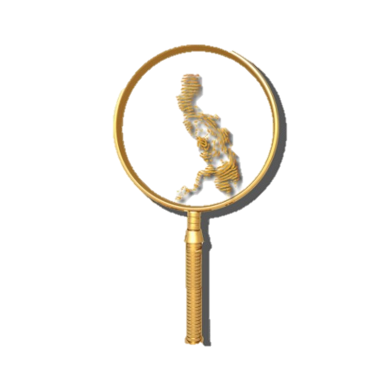
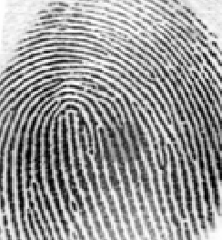
REVIEW QUESTIONS FOCUSED ON COMPETENCY # 4
By: DR. ALFIE P. SARMIENTO, Ph.D.
5th Placer 1998
FISPhil Founding Officer

Slide 2
Question 13
The active substance found on Super Glue, Mighty Bond and similar products utilized in chemical development of latent impression is called
A)Victoria Blue
B)Tetramethyl Benzidine (TMB)
C)Ninhydrin
D)Cyanoacrylate
D) Cyanoacrylate

Slide 3
Ninhydrin process is best for developing latent prints on
Firearm
ransom note
Glass panel
Cell phone

Slide 4
Tetramethyl Benzidine is best used in developing
Latent print on paper surfaces
Metallic surface
Bloody fingerprints
wooden surfaces

Slide 5
Which of the following method is used in developing latent prints in materials which were submerged in water?
Ninhydrin
dusting
Iodine fuming
small particle reagent (SPR)

Slide 6
The following are techniques in fingerprint development except
A)flame technique
B)dusting
C)Chemical development
D)photography
D) photography

Slide 7
Amino acids are secreted by the ______________.
A) Apocrine glands
B) Sebaceous glands
C) Eccrine glands
D) Salivary glands
Eccrine

Slide 8
It is the first time whereby silver nitrate process was used to develop fingerprints.
A) the Lindbergh kidnapping
B) the Hamm kidnapping
C) the OJ case
D) Sam Sheppard case

Slide 9
The matrix of a friction ridge print is the actual substance deposited by the friction ridges. This substance may be:
A) foreign material such as blood, grease, etc.
B) sweat
C) combination of sweat and foreign material
D) all of the above

Slide 10
The primary source of oils and fats found in perspiration is ______, a secretion of the sebaceous glands.
A) urea
B) peptides
C) sebum
D) none of these

Slide 11
Chemical used in the preparation of reagents and dye stains.
A) GENTIAN VIOLET
B) GLACIAL ACETIC ACID
C) GOLD CHLORIDE
D) GOLD TETRACHLORIDE

Slide 12
A solution consisting of acetic acid, selenious acid and cupric salt, used to develop friction ridge detail on metal surfaces.
A) GRAY SCALE IMAGE
B) GUN BLUEING
C) HALLUCAL
D) HEPTANE

Slide 13
A sampling technique used to increase the size of an image file by creating more pixels and increasing the apparent resolution of an image. When used to decrease image size, interpolation is generally referred to as down sampling.
A) INTERDIGITAL
B) Image Retrieval System
C) INTERPOLATION
D) INDIVIDUALIZATION

Slide 14
Emission of light by energy from non-thermal sources (i.e., chemical, biochemical, electrical), including both fluorescence and phosphorescence.
A) LUMINESCENCE
B) INFRARED
C) LASER
D) MICROWAVE

Slide 15
The color bands of light detected during image acquisition, e.g., detection from 520 to 700 nanometers.
A) SPATIAL DENSITY
B) SPATIAL RESOLUTION
C) SPECTRAL RESOLUTION
D) SPECTRAL DENSITY

Slide 16
Suspension in which molybdenum disulphide adheres to fats and oils, allowing for visualization of friction ridge detail.
A) Small Particle Reagent
B) Thenoyl Europium Chelate
C) Reflected Ultra-Violet Imaging System
D) Para-dimethylaminocinnamaldehyde

Slide 17
Secondary treatment of ninhydrin developed friction ridge detail for visualization (e.g. Zinc Chloride, Zinc Nitrate, or Cadmium Chloride); produces a fluorescent product when exposed to selected wavelengths of light.
A) METAL ETCHING
B) MERCURIC NITRATE
C) MERBROMIN
D) METAL SALT

Slide 18
Fluorescent yellow solution used to develop friction ridge detail on the adhesive and non-adhesive sides of dark colored tape.
A) LIQUI-NOX
B) LIQUID NITROGEN
C) LIQUI-DROX
D) LIGROINE

Slide 19
Term commonly used in the United Kingdom and some Commonwealth countries to designate a latent print.
A) Mark
B) Print
C) Matrix
D) Art

Slide 20
A lighting technique used to visualize latent friction ridge impressions where the light is directed on an object in a sloping direction.
A) Forensic Light Source
B) Fluorescence
C) Oblique Lighting
D) Parallel Lighting

Slide 21
Reagent used to detect/enhance bloody friction ridge detail.
A) CYCLOHEXANE
B) CROWLE'S DOUBLE STAIN
C) CRYSTAL VIOLET
D) DIAMINOBENZIDINE

Slide 22
Surface upon which a friction ridge impression is deposited.
A) SUBSTRATE
B) SURFACTANT
C) SYNPERONIC-N
D) SKIN

Slide 23
Chaining together many simple molecules to form a more complex molecule with different physical properties.
A) POLYMERIZATION
B) REDOX
C) RUBBING TECHNIQUE
D) SEQUENTIAL PROCESSING

Slide 24
The first case on record where a latent print was developed on a homicide victim's skin, identified to a suspect, and introduced as evidence in court.
A) State of Florida v. Stephen William Beattie
B) State of Florida v. Victor Reyes
C) State of Illinois v. Jennings
D) State of Maryland v. Bryan Rose

Slide 25
This involves preparing photographic enlargements of the latent and inked fingerprints. A grid of equally-sized squares is then superimposed on each, with the squares of each grid occupying identical positions on each print. The forensic scientist examines both imprints square by square looking for identical characteristics.
A) Osborn Grid Method
B) James Grid Method
C) Purkinje Grid Method
D) West Grid Method

Slide 26
A ridge break may be caused by:
A) a dirt
B) a failure in matrix deposition
C) incorrect deposition pressure
D) any of the above
E) none of the above

Slide 27
Thank you for your Patience!
GOOD LUCK
GOD BLESS!!!

